Slide 1
Dermatology for year 1
Josh Chambers

Slide 2
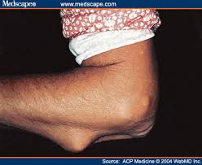
Notes:
Rheumatoid nodules

Slide 3
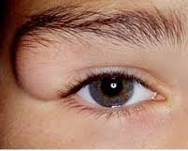
Notes:
A dermoid is an overgrowth of normal, non-cancerous tissue in an abnormal location
Dermatoid cyst

Slide 4
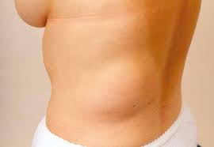
Notes:
Lipoma

Slide 5
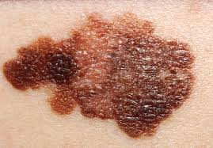
Notes:
Malignant melanoma

Slide 6
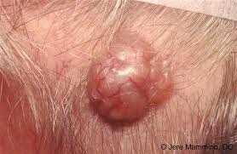
Notes:
Basal cell carcinoma

Slide 7
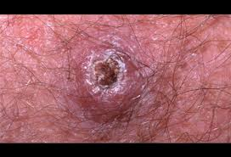
Notes:
Squamous cell carcinoma

Slide 8
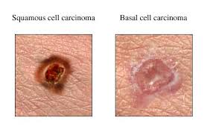

Slide 9
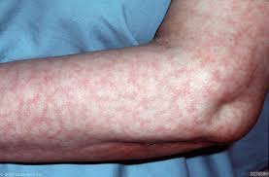
Notes:
Livedo reticularis – antiphospolipid syndrome

Slide 10
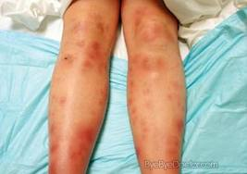
Notes:
erythema nodosum
- Bechets, ReA, Enteropathic spondyloarthropathy

Slide 11
Notes:
ReA

Slide 12
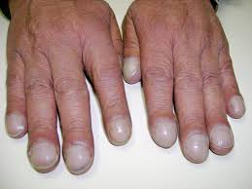
Notes:
This can be caused by a number of conditions that lead to a decrease in the amount of oxygen in your blood, such as lung disease and heart disease.
Clubbing of the fingers

Slide 13
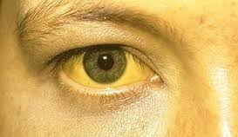
Notes:
Jaundice – Bilirubin – Bile duct obstruction or liver cell damage

Slide 14
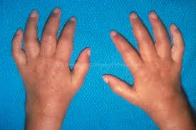
Notes:
Dactylitis

Slide 15
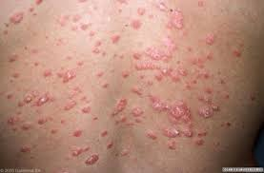
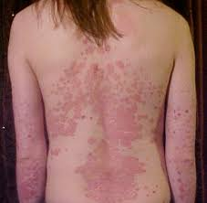
Notes:
Psoriasis

Slide 16
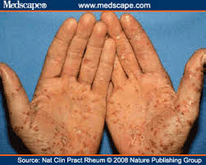
Notes:
Keratoderma Blennorrhagicum - ReA

Slide 17
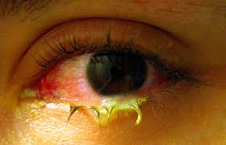
Notes:
Conjuctivitis

Slide 18
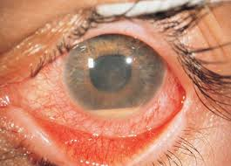
Notes:
Uvitis

Slide 19
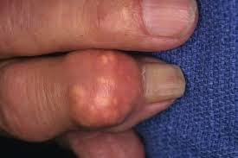
Notes:
Gouty Tophi

Slide 20
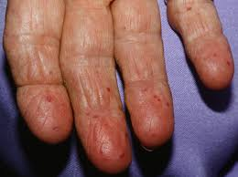
Notes:
Telangectasia

Slide 21
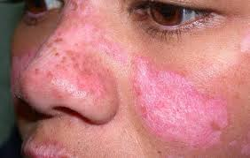
Notes:
Discoid lupus - demarcated, pigmented or atrophic plaques (in photo) This is a form of lupus where only the skin is involved
Malar

Slide 22
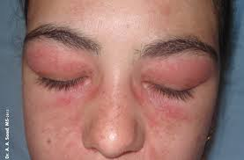
Notes:
Helitope rash – Dermatomyositis

Slide 23
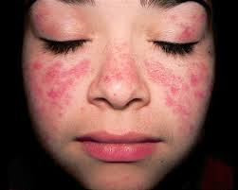
Notes:
Malar rash - SLE

Slide 24
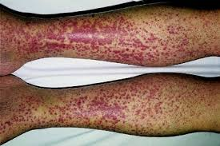
Notes:
CutaneousVasculitis

Slide 25
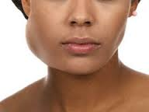
Notes:
Paratoid gland swelling – Sjogrens

Slide 26
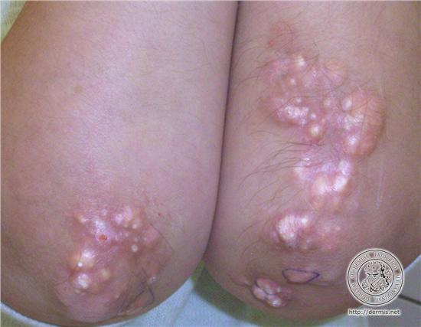
Notes:
Calcinosis

Slide 27
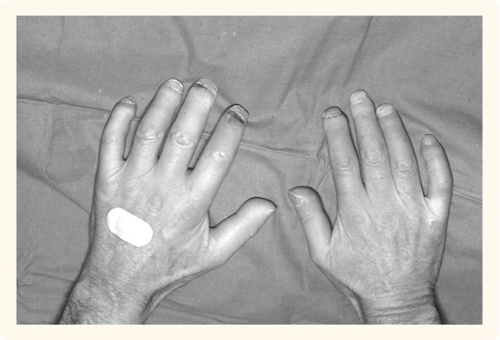
Notes:
Sclerodactlyly

Slide 28
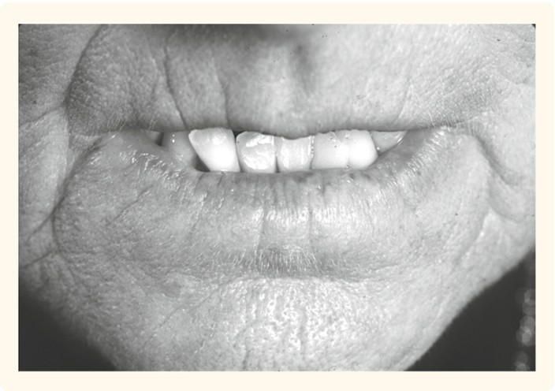
Notes:
Microstomina

Slide 29
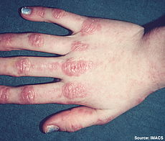
Notes:
Gottrons papules

Slide 30
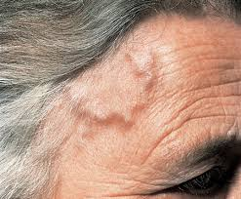
Notes:
Temporal arteritis

Slide 31
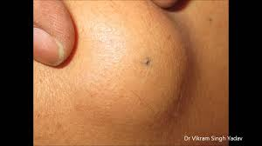
Notes:
Sebaceous cyst

Slide 32
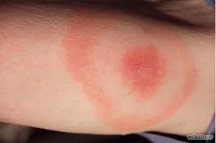
Notes:
Lyme disease

Slide 33
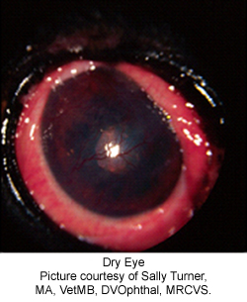
Notes:
Keratoderma conjunctivitis sicca

Slide 34
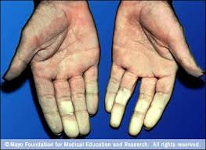
Notes:
Raynauds phenomino/syndrome – common in connective tissue diseases ie SLE, Sjogrens, CREST

Slide 35
Notes:
Umbilical hernia

