Slide 1
Derm quiz

Slide 2
Notes:
Irritant contact eczema

Slide 3
Notes:
Asteatotic eczema looks like a dry river bed – the skin is dry

Slide 4
Notes:
Allergic contact eczema

Slide 5
Notes:
Varicose/stasis eczema

Slide 6
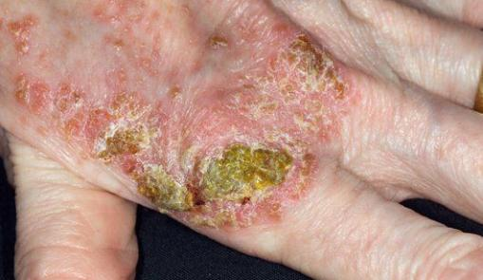
Notes:
Infected eczema

Slide 7
Notes:
Infected eczema (viral) herpes zoster - Eczema herpaticum

Slide 8
Notes:
Discoid eczema

Slide 9
Notes:
Pompholyx eczema

Slide 10
Notes:
Seborrhoeic Eczema

Slide 11
Notes:
Fungal (tinea) hand infection - Tinea manum

Slide 12
Notes:
Chronic dermatitis

Slide 13
Notes:
Acute dermatitis

Slide 14
Notes:
Atopic eczema

Slide 15
Notes:
Seborrhoeic dermititis

Slide 16
Notes:
Plaque psoriasis

Slide 17
Notes:
Scalp psoriasis

Slide 18
Notes:
Koebner pnenomenon

Slide 19
Notes:
Guttate

Slide 20
Notes:
Flexural

Slide 21
Notes:
Brittle

Slide 22
Notes:
Erythrodermic psoriasis

Slide 23
Notes:
Acute pustular psoriasis

Slide 24
Notes:
Napkin psoriasis

Slide 25
Notes:
Palmo-plantar pustulosis

Slide 26
Notes:
Psoriatic nails

Slide 27
Notes:
Acrodermatitis of Hallopeau

Slide 28
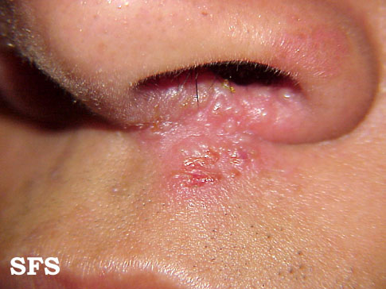
Notes:
Herpes simplex cold sores

Slide 29
Notes:
Herpes simplex

Slide 30
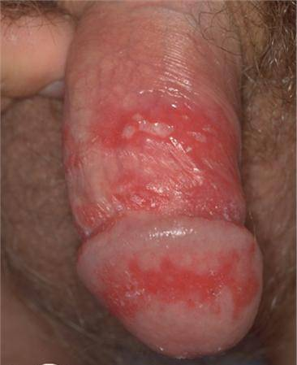
Notes:
Genital Herpes

Slide 31
Notes:
Shingles

Slide 32
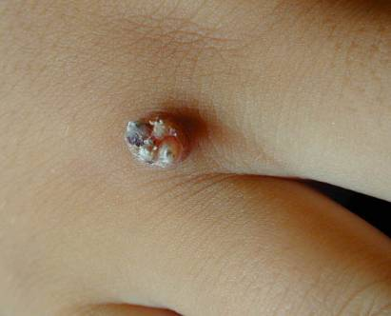
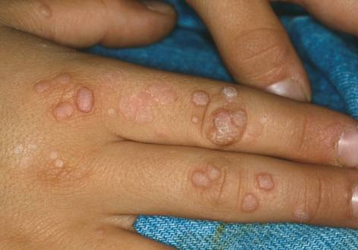
Notes:
Warts

Slide 33
Notes:
Genital warts

Slide 34
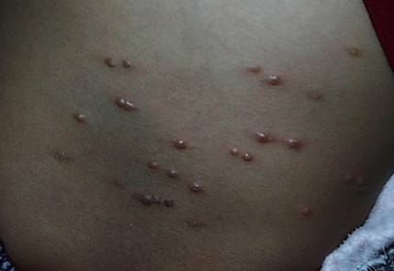
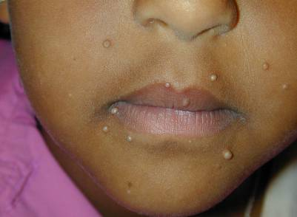
Notes:
Molluscum Contagiosum

Slide 35
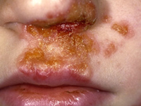
Notes:
Impetigo

Slide 36
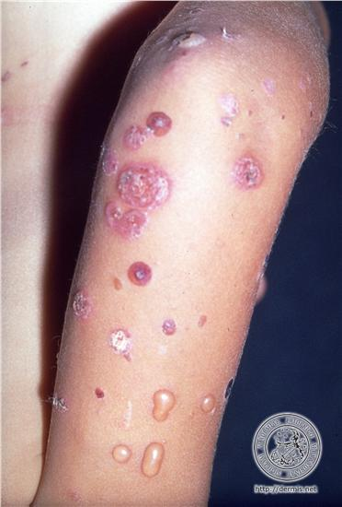
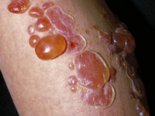
Notes:
Bullous impetigo

Slide 37
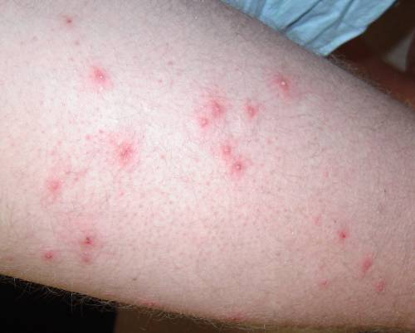
Notes:
Folliculitis

Slide 38
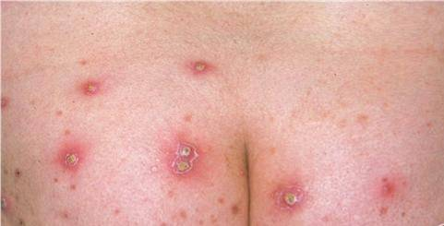
Notes:
Furunculosis

Slide 39
Notes:
Carbuncle

Slide 40
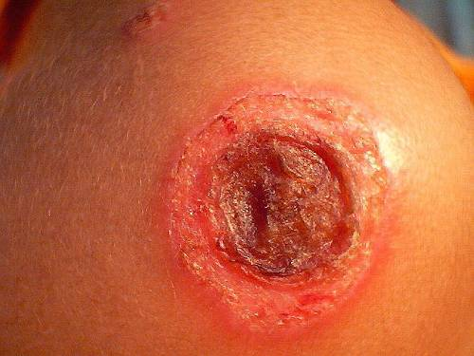
Notes:
Ecthyma

Slide 41
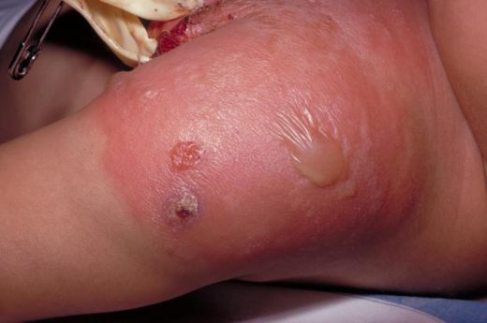
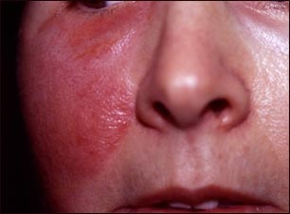
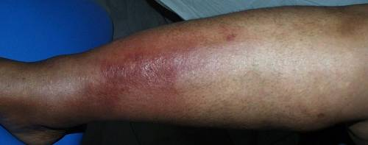
Notes:
Cellulitis (Erysipelas if on face in this pic – better defined)

Slide 42
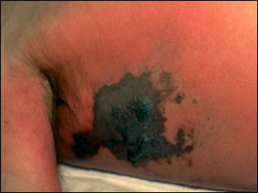
Notes:
Necrotizing fasciitis

Slide 43
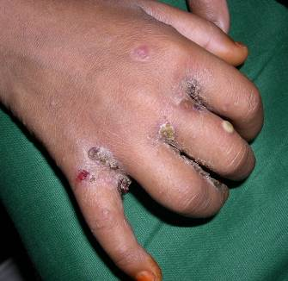
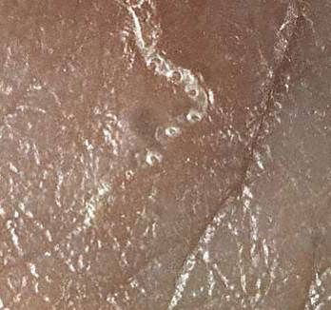
Notes:
Scabies

Slide 44
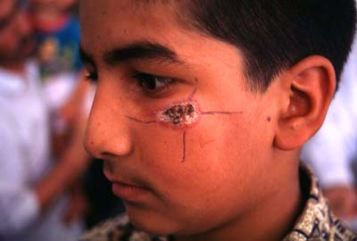
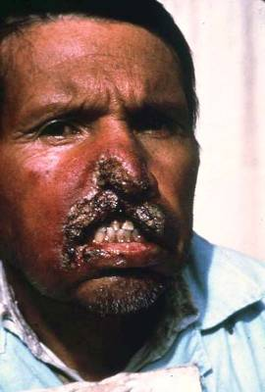
Notes:
Cutaneous leishmaniasis

Slide 45
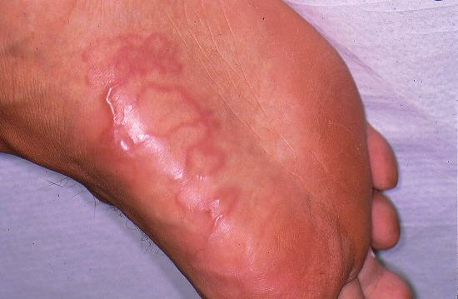
Notes:
Cutaneous Larva Migrans

Slide 46
Notes:
Orf – viral infection, pox virus and endemic in sheep. More common in farmers and vets

Slide 47
Notes:
HSV-1 commonly
Herpes simplex
Same as cold sores

Slide 48
Notes:
Tinea corporis

Slide 49
Notes:
Tinea cruris

Slide 50
Notes:
Tinea incognito

Slide 51
Notes:
Tinea Manuum

Slide 52
Notes:
Tinea capitis

Slide 53
Notes:
Tinea unguium

Slide 54
Notes:
Tinea pedis (Athletes foot)

Slide 55
Notes:
Pityriasis rosea and "herald patch"

Slide 56
Notes:
Urticaria

Slide 57
Notes:
Lichen planus
Bottom left is showing mucous involvement with Wickham’s striae
Typical violaceous papules on the wrist is shown

Slide 58
Notes:
Lichen sclerosis
White lichoid atrophic lesions on the genitalia
Associated with autoimmune disease

Slide 59
Notes:
Erythredema – specifically Sezary disease/syndrome

Slide 60
Notes:
Lichen planus

Slide 61
Notes:
Solar keratosis

Slide 62
Notes:
Solar lentigo

Slide 63
Notes:
Subhorroeic keratosis/wart

Slide 64
Notes:
Blanches – spider naevi

Slide 65
Notes:
Melanocytic nevi – which can change shape and things as a natural disease progression

Slide 66
Notes:
Chondrodermatitis

Slide 67
Notes:
Haemangioma

Slide 68
Notes:
Ephelides/freckles

Slide 69
Notes:
Polymorphic light eruption (PLE)

Slide 70
Notes:
Bowens disease

Slide 71
Notes:
Lentigo maligna
Pre cancer, slow growing pigmented macule on sun exposed areas
3-5 years
Can turn into MM – this is when the melanocytes start to infiltrate
One area can darken, turn black, ulcerate, become symptomatic

Slide 72
Notes:
Seborrheic keratosis

Slide 73
Notes:
Solar keratosis

Slide 74
Notes:
Keratoacanthoma

Slide 75
Notes:
Marjolin’s ulcer
. If a chronic ulcer suddenly starts to grow – think SCC

Slide 76
Notes:
Simple lentigo

Slide 77
Notes:
Junctional naevus

Slide 78
Notes:
Dermal naevus

Slide 79
Notes:
Compound naevus

Slide 80
Notes:
Compound naevus

Slide 81
Notes:
Globular Naevus

Slide 82
Notes:
Reticular naevus

Slide 83
Notes:
Small and large congenital naevus

Slide 84
Notes:
Spitz Naevus

Slide 85
Notes:
Freckles

Slide 86
Notes:
Epidermal naevi

Slide 87
Notes:
Blue naevi

Slide 88
Notes:
Halo naevi

Slide 89
Notes:
Superficial spreading malignant melanoma

Slide 90
Notes:
Lentigo malignant melanoma

Slide 91
Notes:
Acral lentiginous malignant melanoma

Slide 92
Notes:
Nodular malignant melanoma

Slide 93
Notes:
SCC

Slide 94
Notes:
Nodular BCC

Slide 95
Notes:
superficial basal cell carcinoma

Slide 96
Notes:
Infiltrative BCC

Slide 97
Notes:
Bowen’s disease

Slide 98
Notes:
Keratoacanthoma:

Slide 99
Notes:
Cutaneous T-cell lymphoma (CTCL: Mycosis fungoides):

Slide 100
Notes:
Skin tag

Slide 101
Notes:
Epidermal (epidermoid) cyst

Slide 102
Notes:
Milium:

Slide 103
Notes:
Dermatofibroma (Fibrous histocytoma):

Slide 104
Notes:
Pyogenic granuloma:

Slide 105
Notes:
Keloid

Slide 106
Notes:
Campbell-de-Morgan spot

Slide 107
Notes:
Lipoma

Slide 108
Notes:
Chondrodermatitis nodularis:

Slide 109
Notes:
Lentigo maligna

Slide 110
Notes:
Solar (Actinic) keratosis

Slide 111
Notes:
Ecchymosis

Slide 112
Notes:
Petechiae

Slide 113
Notes:
Purpura

Slide 114
Notes:
A dermoid is an overgrowth of normal, non-cancerous tissue in an abnormal location - Dermatoid cyst

Slide 115
Notes:
RA nodules

Slide 116
Notes:
Lipoma

Slide 117
Notes:
Livedo reticularis – antiphospolipid syndrome

Slide 118
Notes:
erythema nodosum
- Bechets, ReA, Enteropathic spondyloarthropathy

Slide 119
Notes:
ReA

Slide 120
Notes:
Dactylitis

Slide 121
Notes:
Gouty Tophi

Slide 122
Notes:
Telangectasia

Slide 123
Notes:
Helitope rash – Dermatomyositis

Slide 124
Notes:
Discoid lupus - demarcated, pigmented or atrophic plaques (in photo) This is a form of lupus where only the skin is involved
Malar

Slide 125
Notes:
Malar rash - SLE

Slide 126
Notes:
Cutaneous vasculitis

Slide 127
Notes:
Paratoid gland swelling – Sjogrens

Slide 128
Notes:
Calcinosis

Slide 129
Notes:
Gottrons papules

Slide 130
Notes:
Sebaceous cyst

Slide 131
Notes:
Lyme disease

Slide 132
Notes:
Raynauds phenomino/syndrome – common in connective tissue diseases ie SLE, Sjogrens, CREST

Slide 133
Notes:
Mumps

Slide 134
Notes:
Measles

Slide 135
Notes:
Fifth’s disease “Slapped cheek”

Slide 136
Notes:
Scarlet fever

Slide 137
Notes:
Candidiasis

Slide 138
Notes:
Cutaneous T-cell lymphoma/mycosis fungoides

Slide 139
Notes:
Bullous Pemohigoid

Slide 140
Notes:
Prurigo nodularis

Slide 141
Notes:
Lichen simplex chronicus

Slide 142
Notes:
Erythema Nodosum

Slide 143
Notes:
Pyoderma gangrenosum

Slide 144
Notes:
Necrobiosis Lipoidica

Slide 145
Notes:
Granuloma Annulare

Slide 146
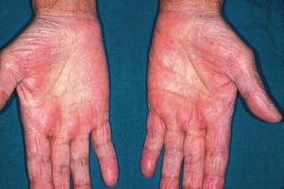
Notes:
Palmar erythema

Slide 147
Notes:
Xanthomas (Hyperlipidaemia is the cause)

Slide 148
Notes:
Spider naevi

Slide 149
Notes:
Xanthomas

Slide 150
Notes:
Tendon xanthoma

Slide 151
Notes:
Eruptive xanthoma

Slide 152
Notes:
Xanthelasma

Slide 153
Notes:
Palmar xanthoma

Slide 154
Notes:
Neurofibroma

Slide 155
Notes:
Café au Lait spots

Slide 156
Notes:
Axillary freckling

Slide 157
Notes:
Top DDx would be Erythema Multiforme

Slide 158
Notes:
Stevens-Johnson syndrome

Slide 159
Notes:
Onychoclasis

Slide 160
Notes:
Pruritic Urticated papules and plaques of pregnancy

Slide 161
Notes:
Pemphigoid Gestationis

Slide 162
Notes:
Intrahepatic cholestasis of pregnancy

Slide 163
Notes:
Granuloma annulare

Slide 164
Notes:
Necrobiosis lipoidica

Slide 165
Notes:
Pityriasis versicolor – m. furfur yeast

Slide 166
Notes:
Meningitis

Slide 167
Notes:
Open comedome

Slide 168
Notes:
Closed comedome

Slide 169
Notes:
café-au-lait marks

Slide 170
Notes:
Vitiligo

Slide 171
Notes:
Albinism

Slide 172
Notes:
Melasma

Slide 173
Notes:
Acanthosis nigricans

Slide 174
Notes:
Amiodarone hyperpigmentation

Slide 175
Notes:
Hand foot and mouth disease – Coxsackievirus

Slide 176
Notes:
Lymphodema with pachydermatosis

Slide 177
Notes:
Inverted champaign bottle legs

Slide 178
Notes:
Contact Dermatitis in a patient with a healed ulcer

Slide 179
Notes:
Arterial leg ulcer

Slide 180
Notes:
Venous leg ulcer

Slide 181
Notes:
Lymphodema

Slide 182
Notes:
Pyoderma gangrenosum

Slide 183
Notes:
Nodular prurigo

Slide 184
Notes:
Prurigo

Slide 185
Notes:
Diabetic foot ulcer

Slide 186
Notes:
Suggests melanoma, specifically acral lentiginous melanoma

Slide 187
Notes:
Hypertrophic scar

Slide 188
Notes:
Keloid scar

Slide 189
Notes:
Atrophic scar

Slide 190
Notes:
Striae

Slide 191
Notes:
AK

Slide 192
Notes:
Sunburn

Slide 193
Notes:
Actinic Cheilitis

Slide 194
Notes:
AK

Slide 195
Notes:
Arsenical keratoses

Slide 196
Notes:
Bowen’s disease

Slide 197
Notes:
Lentigo maligna

Slide 198
Notes:
Infiltrative BCC

Slide 199
Notes:
BCC

Slide 200
Notes:
Superficial BCC

Slide 201
Notes:
Nodular BCC

Slide 202
Notes:
Pigmented BCC

Slide 203
Notes:
Sclerosing BCC

Slide 204
Notes:
Fibroepithelioma of pinkus

Slide 205
Notes:
SCC

Slide 206
Notes:
Cutaneous melanoma

Slide 207
Notes:
Superficial spreading malignant melanoma

Slide 208
Notes:
Nodular melanoma

Slide 209
Notes:
Lentigo maligna melanoma

Slide 210
Notes:
Acral lentiginous melanoma

Slide 211
Notes:
Pressure ulcer

Slide 212
Notes:
Dermatofibroma

Slide 213
Notes:
Wart

Slide 214
Notes:
Corn/Callus

Slide 215
Notes:
Chondrodermatitis

Slide 216
Notes:
Gouty tophi

Slide 217
Notes:
Campbell de morgan spot

Slide 218
Notes:
Sebaceous cyst

Slide 219
Notes:
Demoid cyst

Slide 220
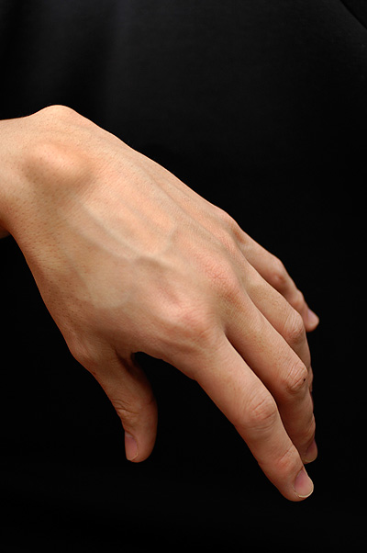
Notes:
Ganglion

Slide 221
Notes:
Glomus tumour

Slide 222
Notes:
Cutaneous horn:
Caused by:
Solar keratosis
Bowens disease
SCC

Slide 223
Notes:
Pyogenic granuloma

Slide 224
Notes:
Myxoid cyst

Slide 225
Notes:
Neurofibroma

Slide 226
Notes:
Tuberose sclerosis

Slide 227
Notes:
Xanthelasma

Slide 228
Notes:
Ingrowing toenail

Slide 229
Notes:
Paronychia

Slide 230
Notes:
Mongolian blue naevi

Slide 231
Notes:
Port wine stain

Slide 232
Notes:
Cavernous haemangioma: Strawberry naevus:

Slide 233
Notes:
Merkel cell carcinoma
MCC is a virus induced cancer
Highly aggressive tumour with a high mortality rate

Slide 234
Notes:
Pemphigus vulgaris

Slide 235
Notes:
Bullous pemphigoid

Slide 236
Notes:
Dermatitis herpatiformis

Slide 237
Notes:
Linear IgA disease

Slide 238
Notes:
Kaposi’s Sarcoma

Slide 239
Notes:
Tinea capitis

Slide 240
Notes:
Androgenetic alopecia

Slide 241
Notes:
Inverse/flexual psoriasis

Slide 242
Notes:
Keratosis Pilaris

Slide 244
Notes:
Lichen Sclerosis

Slide 245
Notes:
Atypical mole syndrome

Slide 246
Mycobacterium ulcerans
Notes:
Fish tank granuloma

Slide 247
Notes:
Erythrasma (More info below)
Erythrasma is a common skin condition affecting the skin folds such as under the arms, in the groin and between the toes.
Erythrasma does not usually cause any symptoms. It presents as a slowly enlarging area of pink or brown dry skin.

Slide 248
Notes:
Linear Nigra

Slide 249
Notes:
Granuloma annularae

Slide 250
Notes:
Lupus pernio – Sarcoid

Slide 251
Notes:
Mouth ulcers – bechets

Slide 252
Notes:
Peutz-Jeghers syndrome:
There is development of non-cancerous polyps in the GI tract
It’s a rare autosomal dominant condition
It causes lentigines around the lips, buccal mucosa and fingers

Slide 253
Notes:
Hereditary haemorrhagic telangiectasia

Slide 254
Notes:
Microstomia

Slide 255
Notes:
Pretibial myxoedema

Slide 256
Notes:
Paget's disease of the nipple

Slide 257
Notes:
Secondary Syphilis

Slide 258
Notes:
Granuloma annularae

Slide 259
Notes:
Necrobiosis lipoidicum

Slide 260
Notes:
Porphyria

Slide 261
Notes:
Polymorphic light eruption

Slide 262
Notes:
Linear IgA

Slide 263
Notes:
Dermatitis herpatiformis

Slide 264
Notes:
Morphoea (Localised scleroderma)

Slide 265
Notes:
Discoid lupus (DDx sweets disease – a variant of RA)

Slide 266
Notes:
Keratosis piliris

Slide 267
Notes:
Autoimmune vasculitis
Patchy ulcers all over the stuff

Slide 268
Notes:
Pressure ulcer

Slide 269
Notes:
BCC

Slide 270
Notes:
HIV related ulcer

Slide 271
A 34-year-old man with a long history of back pain asks you to have a look at his back. His wife has noticed a rash.
Notes:
Erythema ab igne - A typical history would be an elderly women who always sits next to an open fire.

